Slide 1
Evolutionary Synthesis-based Program Repair from Refined Types

Slide 2
Context
Evolutionary Program Synthesis from Refined and Dependent Types
Use the type system to restrict the search space of valid and correct programs.
Æon uses Refined Types to restrict the space of programs it can generate:
Restricted Refined Types
Types that are verifiable with a SMT Solver (z3).
Used to generate non-deterministic valid expressions from a given type.
Non-Restricted Refined Types
Are used to ensure program correctness at runtime using inputs and outputs.
Used to evaluate the program correctness.

Slide 3
Context
type Key {
{key : Integer | key >= 0 && key <= 1024};
}
decrypt(i : Integer, k : Key) → {j : Integer | j > 0} {
i – getKey(k);
}
encrypt(i : Integer, k : Key) → {j : Integer | i == decrypt(j, k.key)} {
i + getKey(k);
}
Restricted Refined Type
✗
Non-restricted Refined Type

Slide 4
Context
import arrays;
sort<T>(array : Array<T>) → out : Array<T> where {array.size == out.size and
elems(array) == elems(out) and
forall(range(out.size - 1), \i:Integer → elemAt(out, i) <= elemAt(out, i + 1))} {
∎;
}

Slide 5
Context - Restricted Refined Types
Non-Deterministic Synthesizer: Synthesizes random valid expressions from a given type.
Non-Deterministic Synthesizer
10
Integer
y + 10
Γ, y:Integer ⊢
if true then 0 else 1

Slide 6
Context - Restricted Refined Types
Non-Deterministic Synthesizer: Synthesizes random valid expressions from a given type.
Non-Deterministic Synthesizer
10
{x:Integer | x > 0}
y + 10 ✗
Γ, y:Integer ⊢
if y < 0 then -y else y + 10

Slide 7
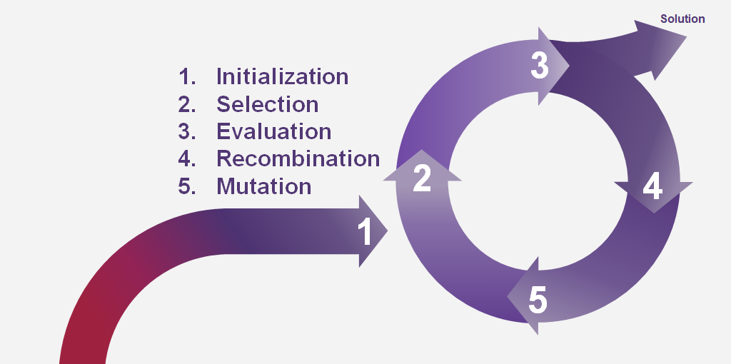
Context - Find the proper program!
The non-deterministic synthesizer provides us different programs that comply with the Restricted Refined Types.
We need to ensure the correctness of the programs,
to do so, we use the Non-restricted Refined Types to help the
search, with Genetic Programming, for the correct
program.
Optimizations of non-functional requirements:
Program size
Resource consumption
Execution time

Slide 8
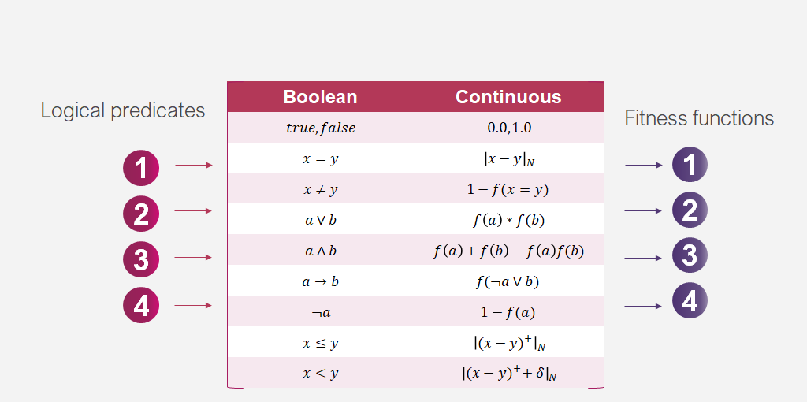
Context - Evaluation
y == f(x) || y <= g(x)
|y - f(x)|N * |(y - g(x))+|N

Slide 9
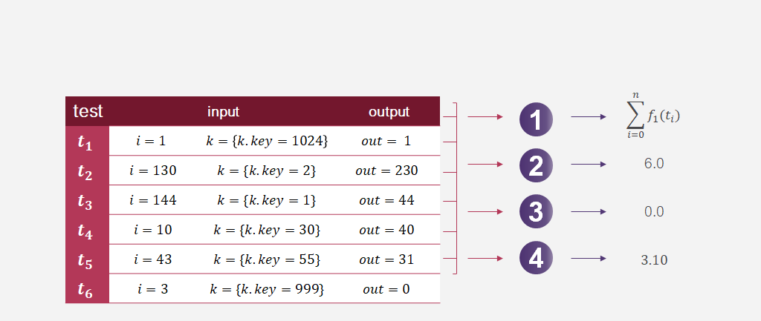
Context - Evaluation
Generate random inputs from the refined polymorphic types of the inputs;
Obtain the results of running each test for the program;
Evaluate the result using the previous fitness functions.
type Key {
{key : Integer | key >= 0 && key <= 1024};
}
decrypt({i : Integer | i > 0}, k : Key) → {j : Integer | i == encrypt(j, k.key)} {
∎;
}

Slide 10
Evolutionary Synthesis-based Program Repair from Refined Types
(the actual system)

Slide 11
Evolutionary Synthesis-based Program Repair from Refined Types
Use the previous concepts to automatically repair programs whose behavior does not match the user intention.
public int fibonacci(int x) {
if (x <= 10)
return x;
else
return fibonacci(x - 1) + fibonacci(x - 2);
}

Slide 12
Evolutionary Synthesis-based Program Repair from Refined Types
Since programmers do not like to write specifications, or if the target language does not have refined types, we need a way to obtain the user intention.
Test Suite
Unit Tests Assertions
input | output
3 | 2
10 | 55
14 | 377
... | ...
The user provides unit tests, and we use the assertions to evaluate program correctness.

Slide 13
Evolutionary Synthesis-based Program Repair from Refined Types
If a test suite is provided, similarly to Daikon, obtain the refinements for the buggy function.
RISKS:
We are required to filter spurius invariants;
Daikon approach requires instrumentation (slows down program execution).
public Object topAndPop() {
if (isEmpty())
return null;
Object topItem = top();
theArray[topOfStack--] = null;
return topItem;
}
============================================
StackAr:::OBJECT
this.theArray != null
this.theArray.getClass().getName() == java.lang.Object[].class
this.topOfStack >= -1
this.topOfStack <= size(this.theArray[])-1
============================================

Slide 14
Evolutionary Synthesis-based Program Repair from Refined Types
The synthesis of the patch is done using components (values, variables, functions). If the target language does not contain refinement types, there are two approaches to obtain these:
Infer the Refined Types
Libraries with refined types
Statically infer the refinements[1, 2] for all the available components for the synthesis-based repair.
[1] Leandro T. C. Melo, Rodrigo G. Ribeiro, Marcus R. de Araujo, and Fernando M. Q. Pereira. 2017. Inference of static semantics for incomplete C programs. Proc. ACM Program. Lang. 2, POPL, Article 29 (December 2017), 28 pages.
[2] Patrick M. Rondon, Ming Kawaguci, and Ranjit Jhala. 2008. Liquid types. In Proceedings of the 29th ACM SIGPLAN (PLDI ’08). New York, NY, USA, 159–169.
We ensure “good” API’s that describe the behaviour of the components with refinement types.
For libraries, such as RosPy and RosCpp, we could provide the refinement types.

Slide 15

Evolutionary Synthesis-based Program Repair from Refined Types
Convert the non-restricted refined types (dependent types) deduced from the program traces into continuous fitness functions.
Generate random tests according to the refinements to prevent overfitting the patch (metamorphic testing).
Use the non-deterministic synthesizer and the synthesis approach previously described to generate the patch.
file
Fixed
Program
Refined Type Dynamic Inference
Components Static Refined Inference
Evolutionary Patch Synthesis
test
suite
Non-deterministic Synthesizer

Slide 16
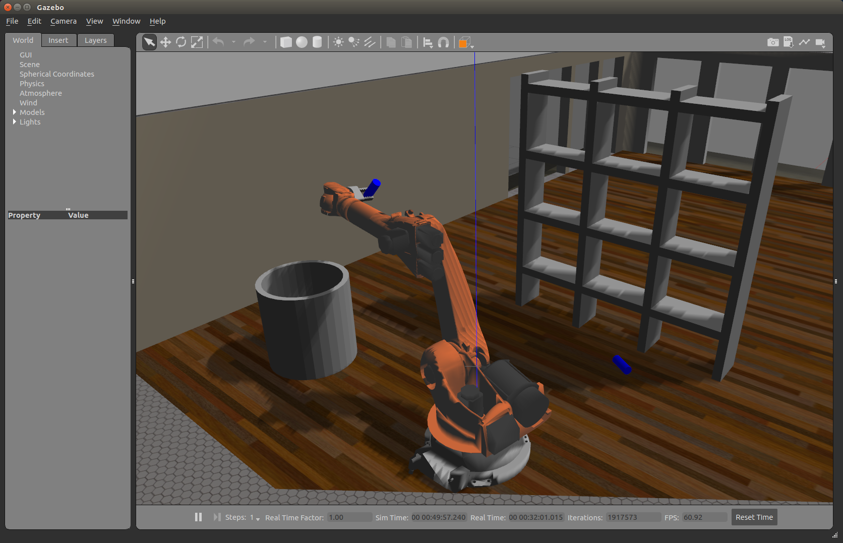

Application: Repairing and Improving Robot Software
Test Input Generator
Refined Types
Test Oracle
Notes:
During an offline step, we learn the refined types using a cloud computing platform. This allows us to reduce the size of the search space at runtime.
CMU has extensive tooling and infrastructure for generating tests, simulating robots, and checking correctness. Numerous input generation and oracle methods can be used here. The approach described is agnostic to the implementation of those components. Oracles can include, for example, safety invariants, QoS metrics, Mithra, mined specifications, and LTL/STL formulae.

Slide 17
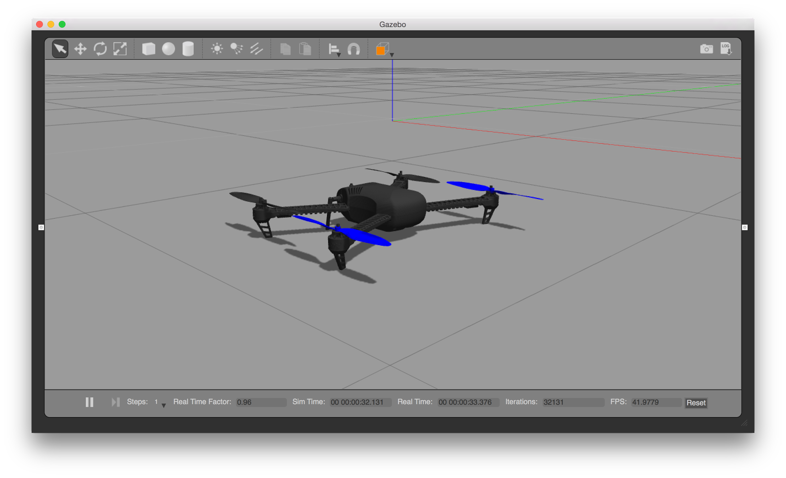
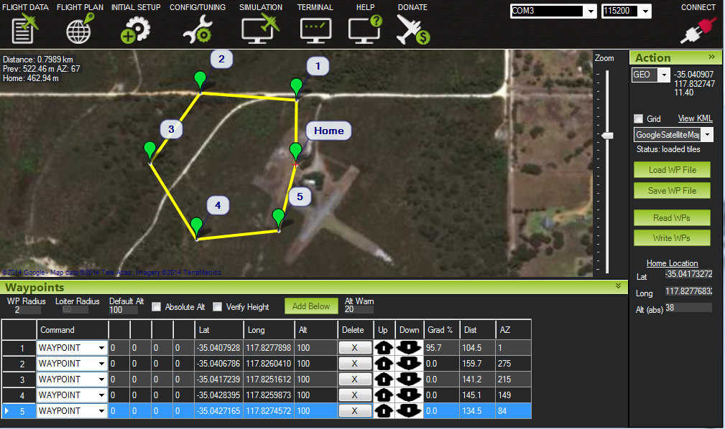
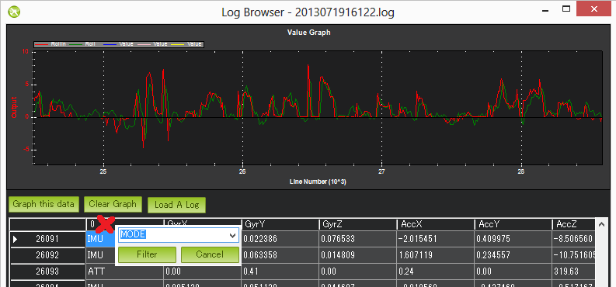
Online Step: Attack recreation in simulation via “record and replay”
mission description
low or high-fidelity simulation
telemetry and communication logs
Notes:
Provide a “witness”/proof of vulnerability, automatically derived from log data, that reproduces a bug in the robot.

Slide 18








PREFLIGHT
INFLIGHT
DIAGNOSIS
REPAIR
1
2
4
5
6
VALIDATION
3
DETECTION
Notes:
CMU has already demonstrated this concept for a UAV platform, ArduPilot, as part of the AFRL TRMO program.
In that program, we used search-based program repair (inspired by GenProg and AE) to repair vulnerabilities in an autonomous quadcopter live in the field. Most of the work was focused on the various prerequisite challenges required to perform repair on a robot system in the field, and little innovation went into the search algorithm used to construct repairs.

Slide 19
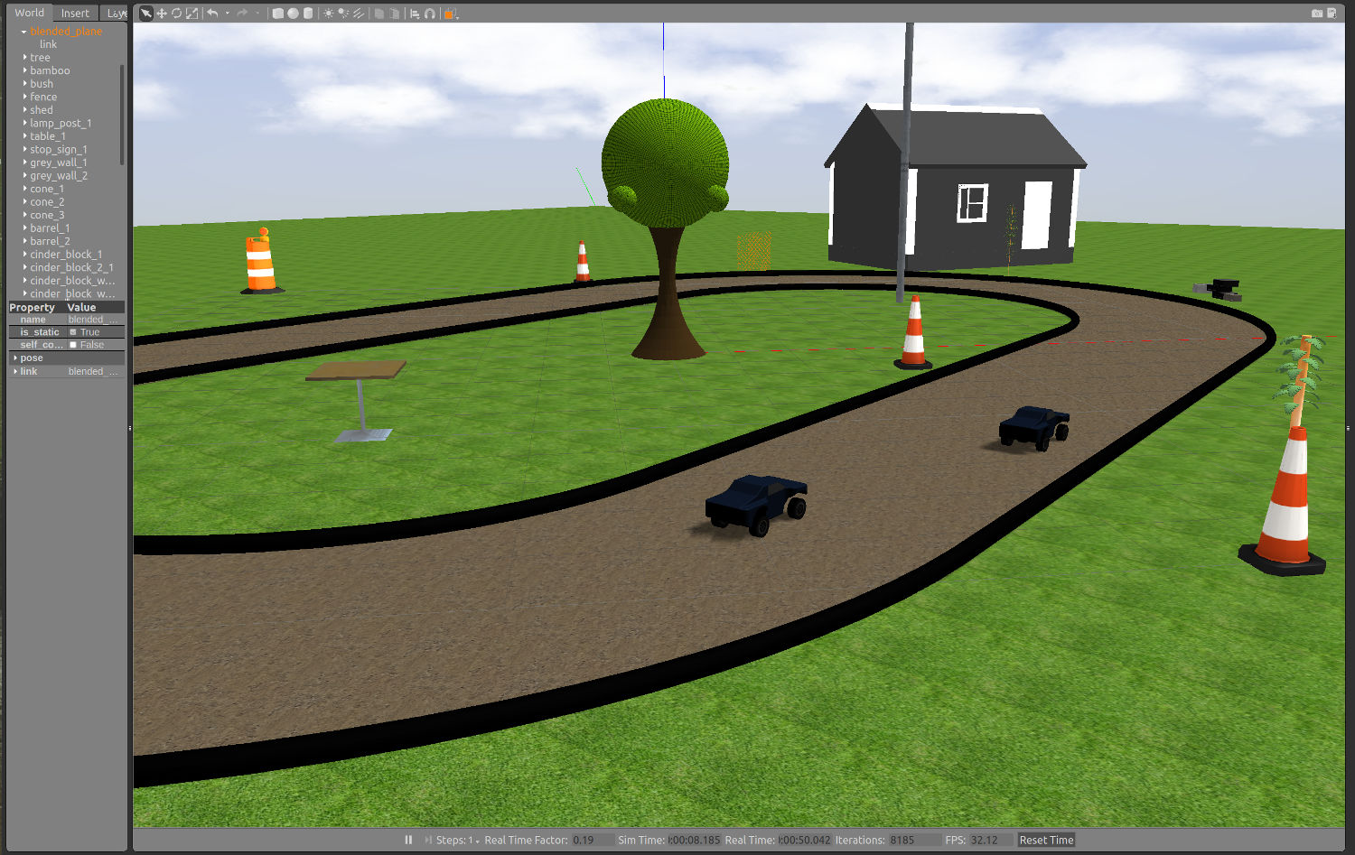


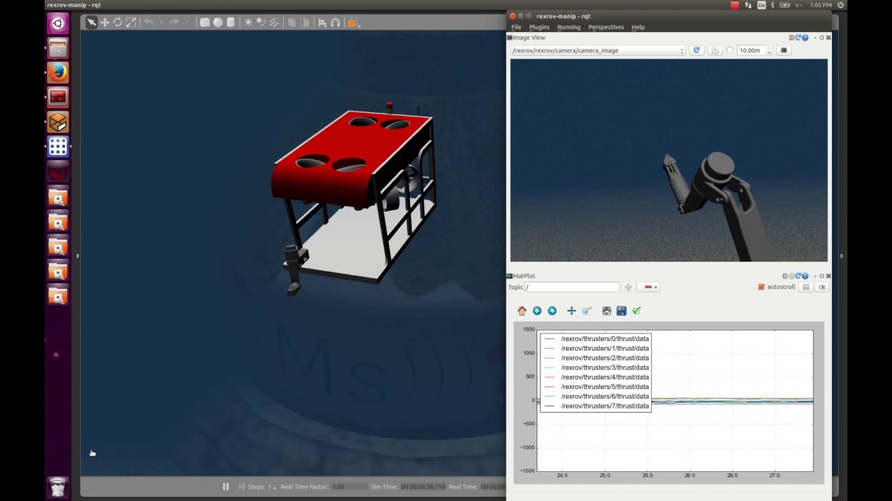
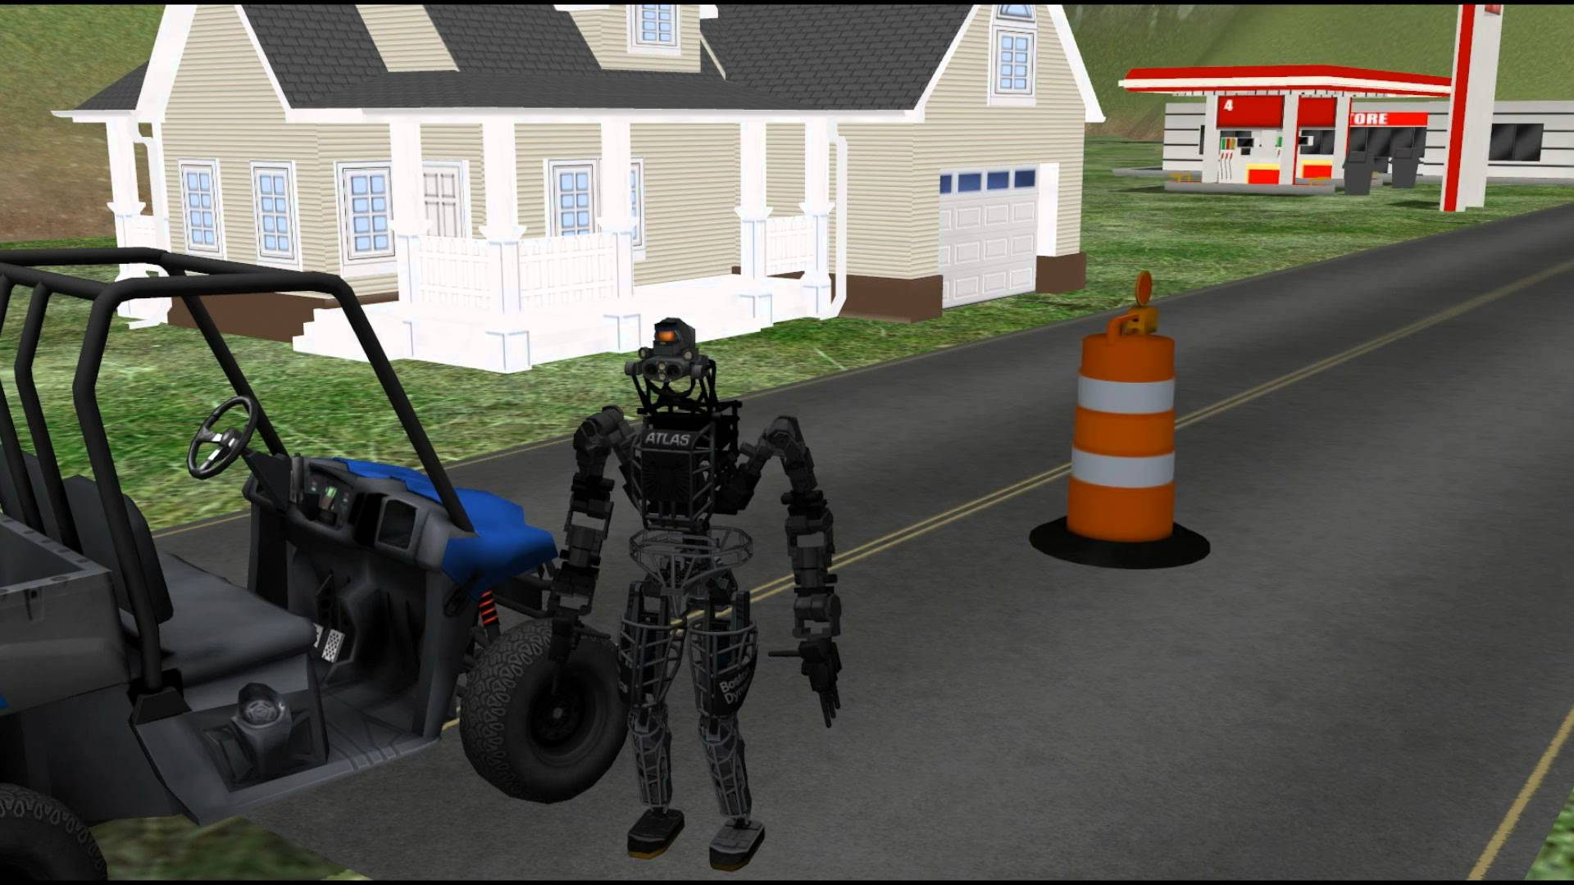
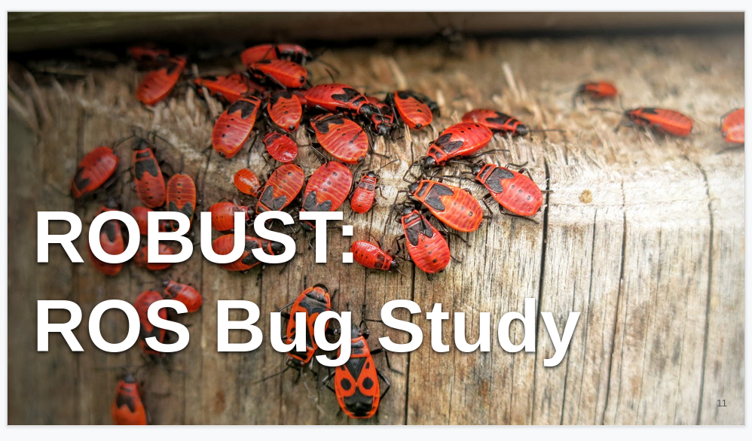
We have several datasets with robot applications and historical bugs
Notes:
ROBUST is a collection of over 200 historical bugs in a variety of popular ROS packages: https://github.com/robust-rosin/robust/

